Slide 1
Device security system against unknown users attacking-both internally and externally
Team binary

Slide 2
Features of our Device security system
I. USING FACIAL RECOGNITION AND ZERO TRUST POLICY AS FOUNDATION SECURE YOUR DEVICE FROM LOCAL PERSONNEL INFILTRATIONS
II. DEFENSE AGAINST POSSIBLE RISKS AS SOON AS THEY INVADE THE DEVICE /MALWARE DETECTION BEFORE IT SETS OFF DETECTION OF MALWARE BEFORE IT TRIGGERS WHEN USING UNKNOWN DATA FILES

Slide 3
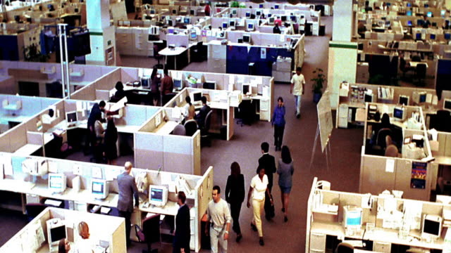
I. Modern day workspaces
The harsh reality of today's workplaces, where workers are required to sit in cramped cubicles, was exposed by Sir Rishi Bagga. Due to this, our devices are susceptible to being accessed by coworkers who are seated close to us.

Slide 4
Binary’s solution
Based on Zero Trust Policy and facial recognition to identify individuals behind the screen.
Clicks pictures at definite time intervals and compares with the pictures of the owner/authorized users of the device.
Locks the device if an unauthorized individual is detected.
Captures the picture of the intruder and stores it locally.
Uses Azure Cloud Services to store the facial recognition data of the user for verification.

Slide 5
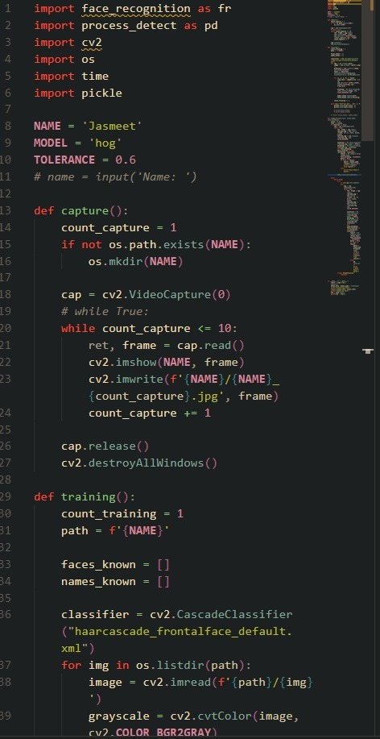
Our approach
Detecting and cropping photos of the face using haar-cascade .
Converting them to monochrome.

Slide 6
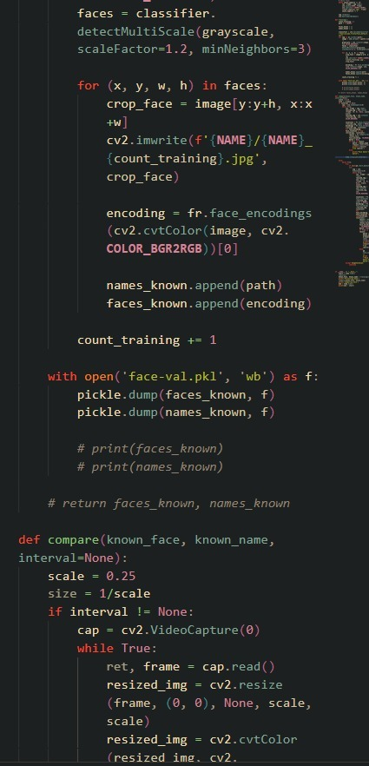
Our approach
Training and testing our model and dividing the dataset in a 70:30 split.

Slide 7
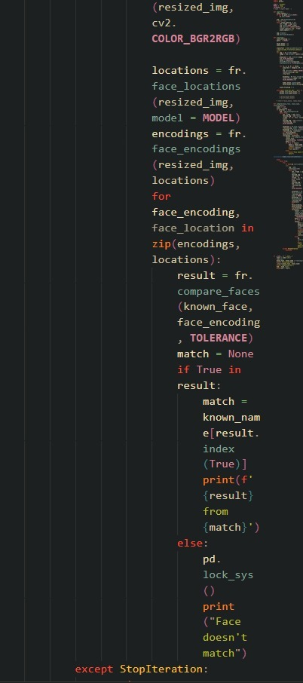
Our approach
Labelling the images of the dataset to be used for verification
Using CNN provided by TensorFlow to train the model for verification of faces.

Slide 8


Our approach
Tech Stack
Python
OpenCV
Face-recognition
OS Module
Tkinter
Azure Services
Face API
Azure SQL Database

Slide 9

II. existing security utility programs
Computers that are compromised with malware are often networked together to form botnets, and many attacks are launched using these malicious, attacker-controlled networks. By the time the anti-virus or anti-malware detects it, it has already done some of its work or is in process of the same.

Slide 10
BINARY’S SOLUTION
Detection of malware before it triggers.
Used PEfiles (portable executed files) to differentiate between malware and uninfected files.
Used Dataset of 140,000 malwares and uninfected files.
Machine Learning algorithm used random forest classifier.

Slide 11
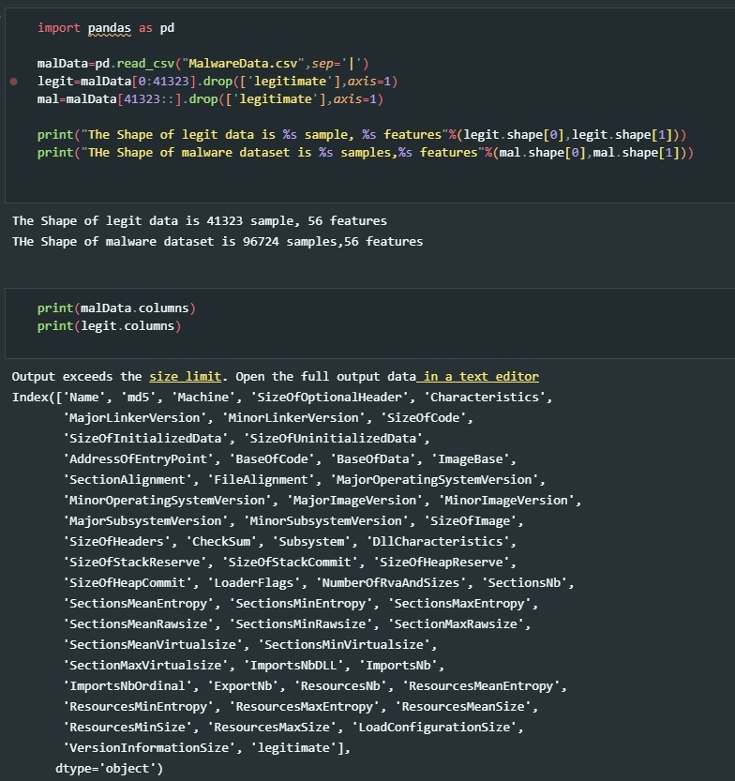
Our approach
1. Using pandas to load our dataset

Slide 12
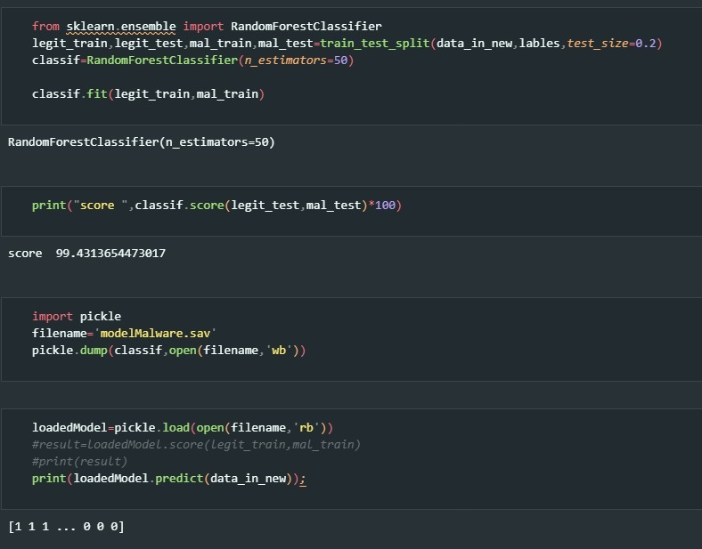
Our approach
2. Building and testing our machine learning model

Slide 13
Our approach
Tech Stack
Python
Pandas
PEfiles

Slide 14
Thank you ~Team binary
"One single vulnerability is all an attacker needs“
- Window Snyder
Chief Security Officer, Fastly

